Slide 1
Is All That Talk Just Noise? The Information Content of Internet Stock Message Boards
Authored by Werner Antweiler and Murray Z. Frank
Presented by: Suisui Huang
Notes:
Both authors are at the Sauder School of Business, University of British Columbia

Slide 2
Agenda
Research Results Preview
Paper Structure
  Message Board Data and Classification (Data pre-processing)
  Data Description
  Relating Message Boards and Stock Returns
  Volatility
  Trading Volume
My Opinions
Notes:
Here’s my agenda today
FIRST of all, we will have a preview of the research results
There are three issues discussed in this paper

Slide 3
Research Results Preview
Three specific issues considered
Does the number of messages posted or the bullishness of these messages help to predict returns?
Is disagreement among the messages associated with trading volume?
Does the number of messages posted or the bullishness of the messages help to predict volatility?

Slide 4
Research Results Preview
The First Issue
Question:
Does the number of messages posted or the bullishness of these messages help to predict returns?
Result:
An increase in the number of messages posted has a statistically significant but economically small negative return on the next day

Slide 5
Research Results Preview
The Second Issue
Question:
Is disagreement among the messages associated with trading volume?
Historical Researches (Opposite opinions):
Traditional Hypothesis: Disagreement induces trading
No-trade Theorem: Disagreement leads to a revision of market prices and beliefs
Result:
Disagreement induces contemporaneous trading but reduces the trading volume on the next day
Notes:
Traditional Hypothesis: Disagreement induces trading
(Hirshleifer(1977),Diamond and Verrecchia(1981), Karpoff(1986), Harris and Raviv(1993) )
No-trade Theorem: Disagreement leads to a revision of market prices and beliefs
(Milgrom and Stokey(1982))

Slide 6
Research Results Preview
The Third Issue
Question:
Does the number of messages posted or the bullishness of the messages help to predict volatility?
Model for volatility:
Fractionally integrated realized volatility news response function
Result:
Message posting and trading volume help predict volatility

Slide 7
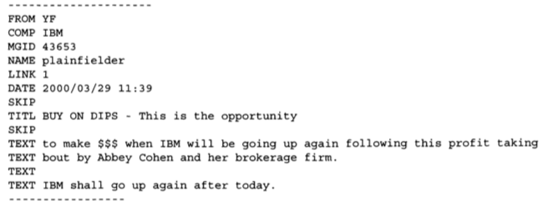
  Message Board Data and Classification
Message Data collection (Data Pre-processing Part 1)
Source: Yahoo! Finance & Raging Bull message boards
Object: 45 firms that together made up the Dow Jones Industrial Average (DIA) and the Dow Jones Internet Commerce Index (XLK).
Format:
1.5 million text messages
Bullish?
Bearish?
Neither?
Notes:
Those firms are fairly large and well-known
to download messages Wrote a specialized software to store messages in the following format
The problem here is that, for our research, we need to classify those messages into different categories. Is it bullish or bearish or neither?
If we do this work manually it would take forever, that’s why we need to utilize a well-known machine learning model named “Naïve Bayes Classification” to automatically
accomplish this classification in just a few minutes

Slide 8
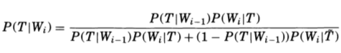
  Message Board Data and Classification
Naïve Bayes Classification Method
Key Assumption: Occurrences of words are independent of each other (Naïve)
Procedure:
Consider a stream of words W_{i} that are found either in a message of type T or itsanti-type T-prime
Updating Rule:
With
m_{i}: the number of occurrences of this word W_{i} in type T
m_{i}-prime: the number of occurrences of this word W_{i} in anti-type T-prime
n_{i}: the total number of words in type T
n_{i}-prime: the total number of words in type T-prime
Notes:
Though the assumption may be somewhat unrealistic, the model performs rather well in practice.
It allow us to ignore grammatical structure
Now consider Bayes' rule, updating our prior P(T|W_{i-1}) to posterior P(T|W_{i}) when we observe word W_{i}

Slide 9
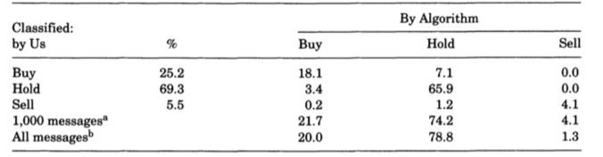
  Message Board Data and Classification
Naïve Bayes Classification Method
Procedures:
Manually split 1000 messages into buy, sell and hold
Run a software named rainbow, set ’Naïve Bayes’ for method, get 3 probabilities P(T|W^{k} ）for each message k and each categories T (Buy, hold or sell)
Choose the classification with the highest probability for message k
In-sample Accuracy:
Notes:
In-sample accuracy is 18.1+65.9+4.1=88.1%

Slide 10



  Message Board Data and Classification
Aggregation of the Coded Messages (Data Pre-processing Part 2)
Bullishness signal B_{t}:
M_{t}^{Buy} : total number of messages in category ‘BUY’ during the time interval t.
M_{t}^{Sell} : total number of messages in category ‘SELL’ during the time interval t.
Agreement Index A_{t}:
Notes:
Xi is an indicator variable that is one when message I is of type c and zero otherwise
So it makes Bt the average of X1
The volatility can a representative of disagreement
At=1-vol, which can naturally be a representative of agreement
If we do not observe any messages in a given time period, we assume that the bullishness signal is neutral, namely B=0,then A=0 as well. Intuitively, periods without

Slide 11
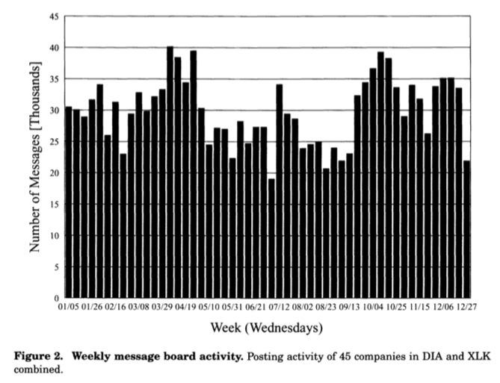
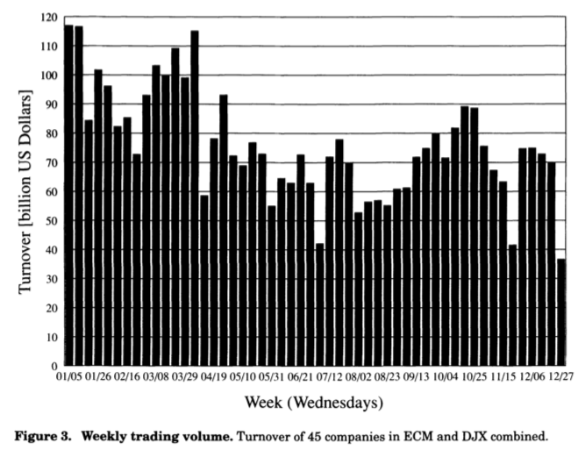
  Data Description
Messages & Financial Data
Figure2 shows the weekly message posting over the full year 2000
message posting activity was reasonably stable over the year
Figure3 shows the weekly trading volume over the full year 2000
There was a decline in the volume of stock trading over the year
The trading volume is often elevated during the same week that message posting is elevated

Slide 12
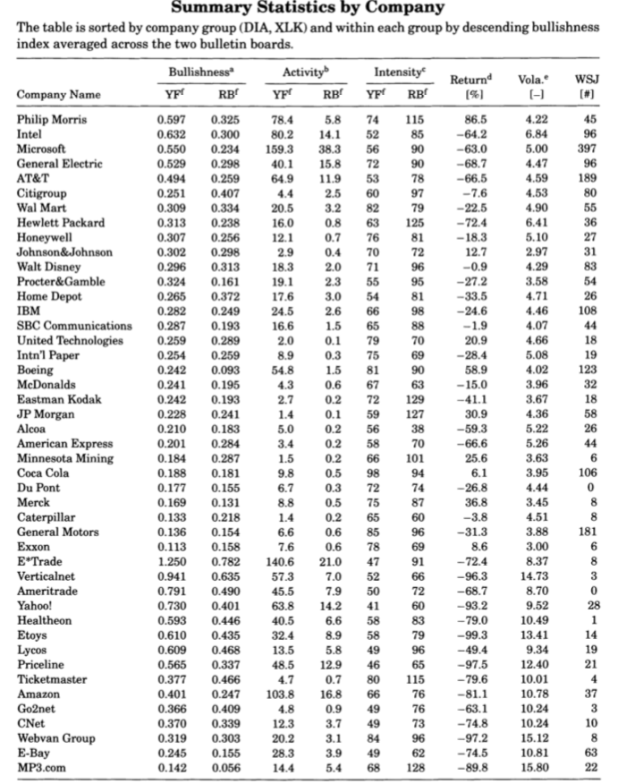
  Data Description
Messages & Financial Data
Yahoo! Finance vs Raging Bull:
More messages
More bullishness
Shorter messages
DIA vs XLK:
Lower losses
Lower volatility
Lower activity levels
Less bullishness
Higher level of coverage by WSJ
Notes:
This table reports a number of descriptive statistics for our 45 sample companies

Slide 13
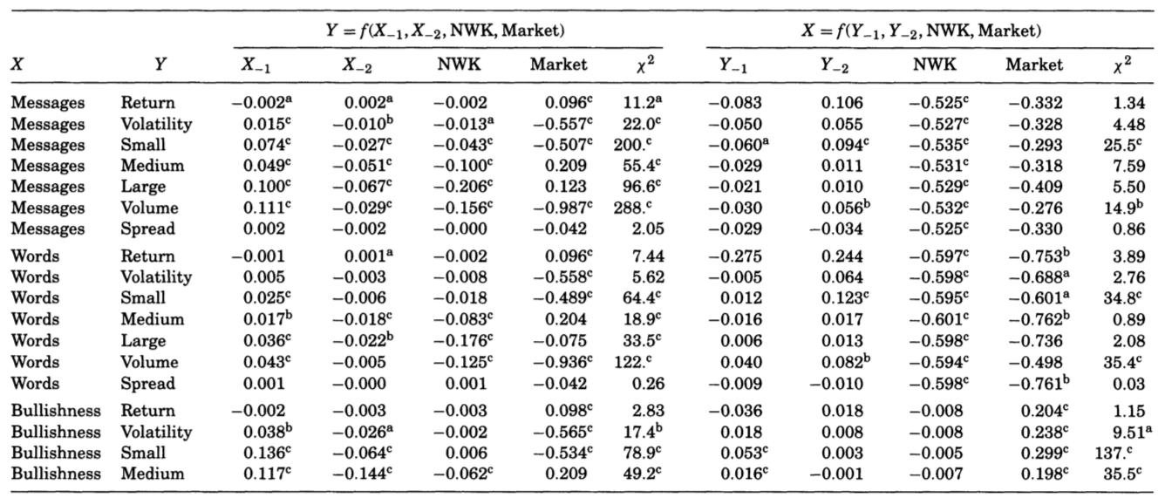
  Relating Message Boards and Stock Returns
Time sequencing tests
Significant negative relationship between the number of messages on day t and stock returns on day (t+1).
Significant positive relationship between the number of messages on day t and stock returns on day (t+2).
Results:
The return predictability is statistically significant but very small in magnitude
Difficult to take advantage of because potential gains would likely be offset by small transaction costs
Notes:
NWK is an indicator variable for a day being the first trading day after a weekend or holiday
If the coefficient is significant then it would be indicated with a superscript
a denotes significance at 99% level b 99.9% c 99.99%

Slide 14
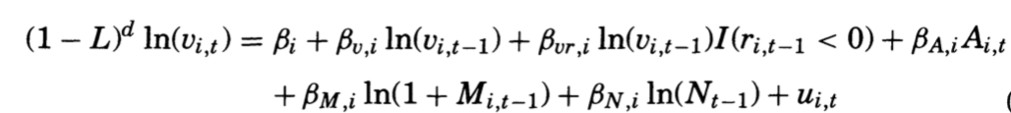
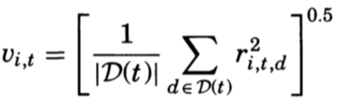

  Relating Message Boards and Volatility
Fractionally integrated realized volatility news response function
1. What is V_{i,t}：
2. What is d (fractional integration parameter)：
*Log-periodogram method (Geweke and Porter-Hudak(1983))
Using estimates of the periodogram for company i at frequency points k=0,1,...,T^0.6, we get d=0.3097
R_{t,i,d}: Return of company i on day t and intra-day period d (15 mins)
V_{i,t}: Volatility of company i on day t
Notes:
When we are modeling volatility, we usually use only previous volatility as independent variables, however, in our case, our central interest is in understanding the extent to which the message boards have an impact on the realized volatility. That’s why we introduce A M and N here
Google FIGARCH and GPH for more details

Slide 15
  Relating Message Boards and Volatility
Fractionally integrated realized volatility news response function
3. What is I(r_{i,t-1}<0)：
4. What is L,A, M and N:
L: Lag operator
A: Agreement Index
M: Number of messages
N: Number of trades
An indicator variable for yesterday’s return to be negative
Leverage effect:
When the coefficient is not 0, then there exists leverage effect.
The sign of yesterday’s return, negative or positive, will have an impact on today’s volatility
Notes:
L is a lag operator. See white board for details.

Slide 16
  Relating Message Boards and Volatility
Time sequencing tests
We can predict volatility using the message posting data
More messages today imply significantly greater market volatility tomorrow
Message posting activity has a more significant effect on market volatility than market volatility has on message posting

Slide 17
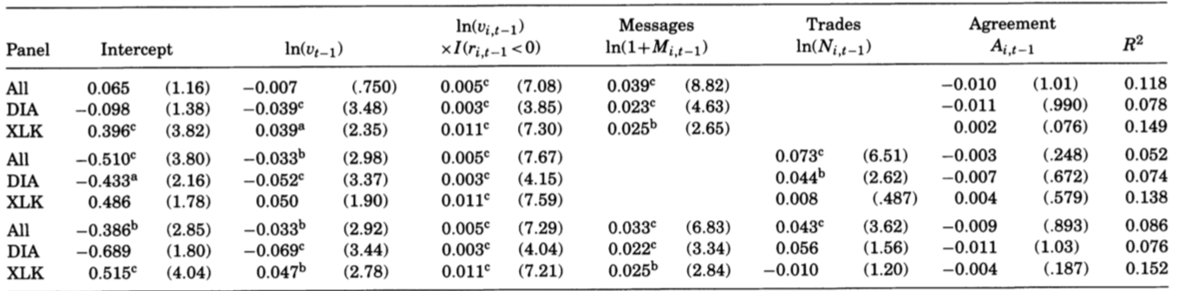
  Relating Message Boards and Volatility
Volatility Panel Regressions
The number of messages is a predictive factor of volatility for both DIA and XLK firms
The number of trades is a significant factor for the DIA firms, but not significant for the XLK firms
Agreement among the posted messages is not significant

Slide 18
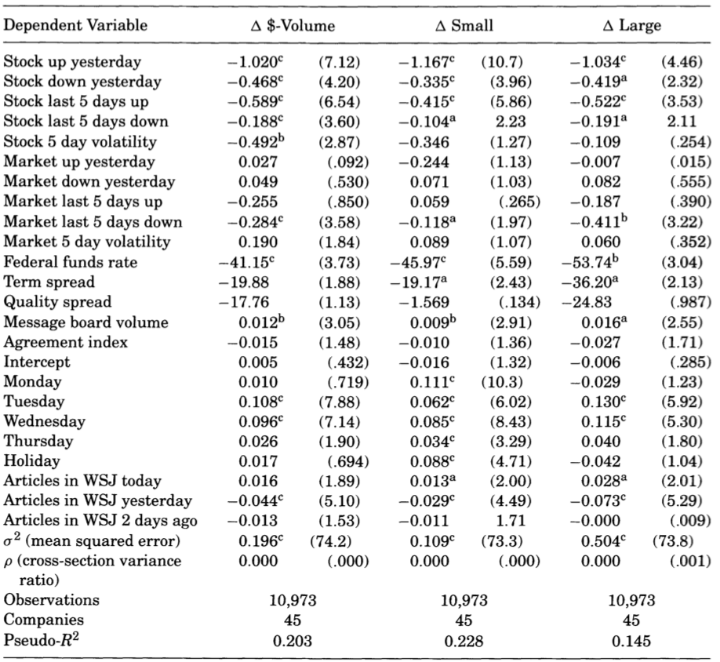
  Relating Message Boards and Trading Volume
Volume regressions
WSJ’s effect
If there is an article in today’s WSJ, trading is elevated. If there was an article in yesterday’s WSJ, then todays trading is depressed
Message posting
The message board posting volume remains a predictor of trading volume. The sign is positive and it is statistically significant
Notes:
Contemporaneous Regressions
Although the magnitudes are economically smaller. The explanatory power of the volume regressions is quite high

Slide 19
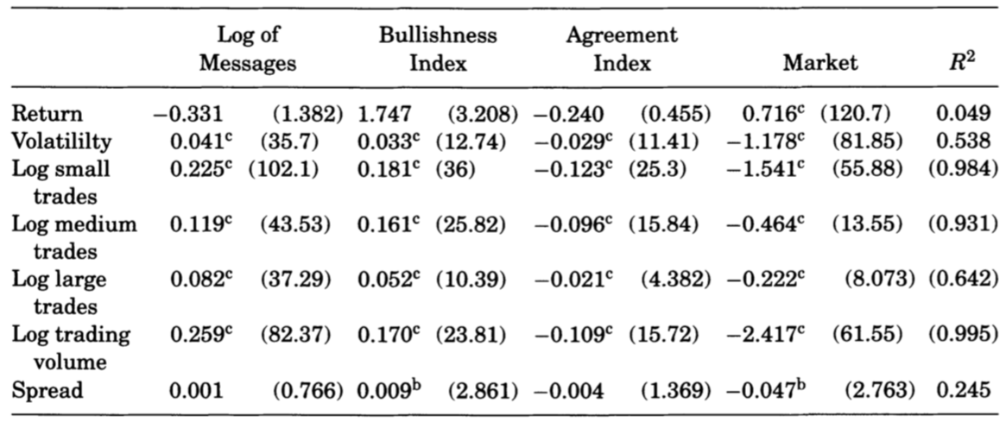
  Relating Message Boards and Trading Volume
Contemporaneous Regressions
The Contemporaneous Regressions support for the hypothesis that disagreement produces trading
Notes:
Contemporaneous Regressions

Slide 20
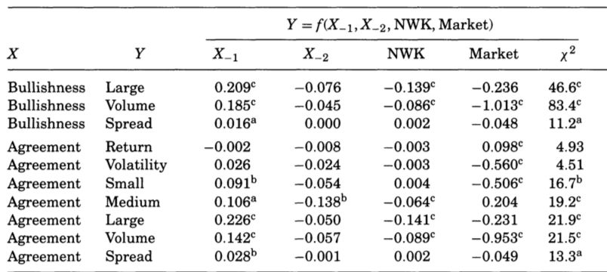
  Relating Message Boards and Trading Volume
Time sequencing tests
Greater agreement on a given day is followed by more trades on the next day
“Sluggish traders hypothesis”: It takes a while for people to get around to completing their trades.
Cao(2002) suggests that when a person learns that others have received the same signal that they have received, this will make them more willing to trade
Notes:
Namely, greater disagreement will reduce the trading volume

Slide 21
My Opinions
Agreement
Disagreement
Innovative model for volatility
Interesting results found between message posting and return
Test error for Naïve Bayes Method?
R square for volume regressions relatively small
Granger causality test
Notes:
An increase in the number of messages posted has a statistically significant but economically small negative return on the next day

Slide 22
Thanks for your time!
Any questions?

